Slide 1


EVERGREEN SMART DUSTBIN
By ETP Group 13 – Jan 2022

Slide 2
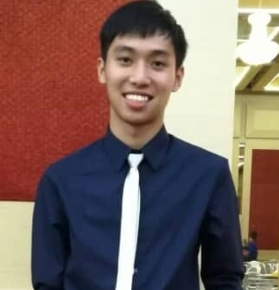
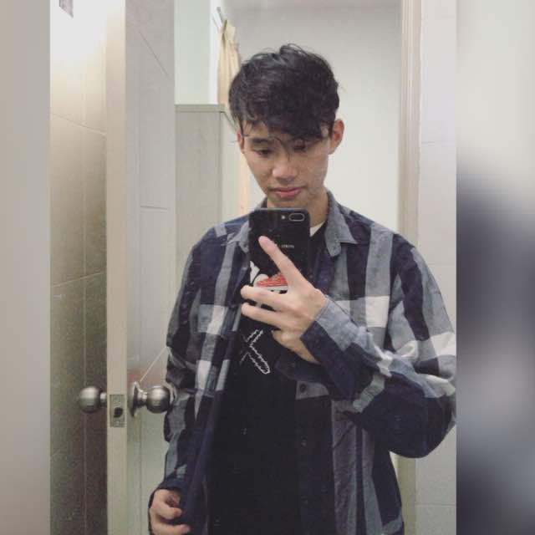
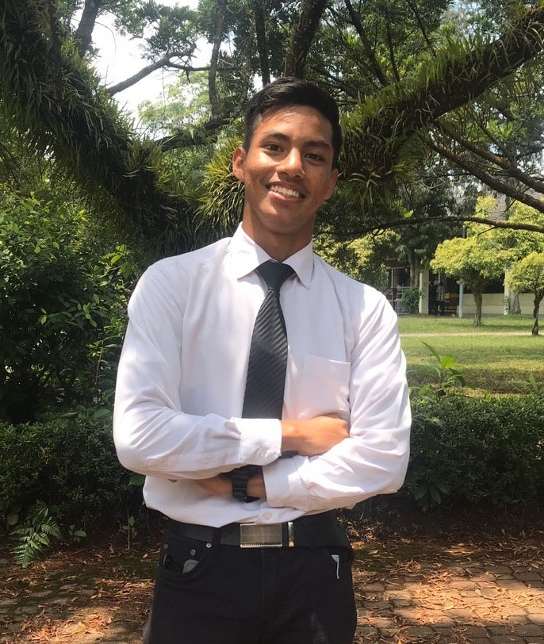
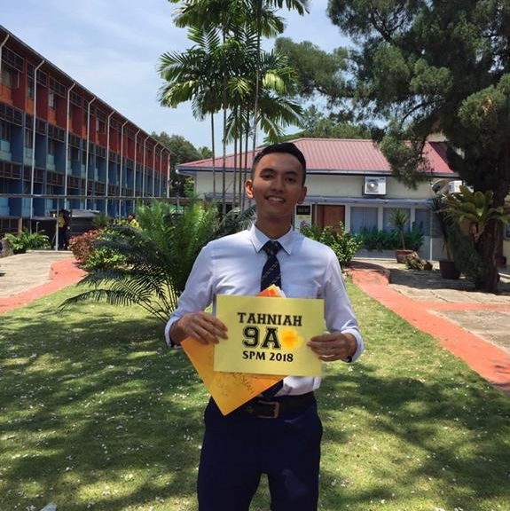
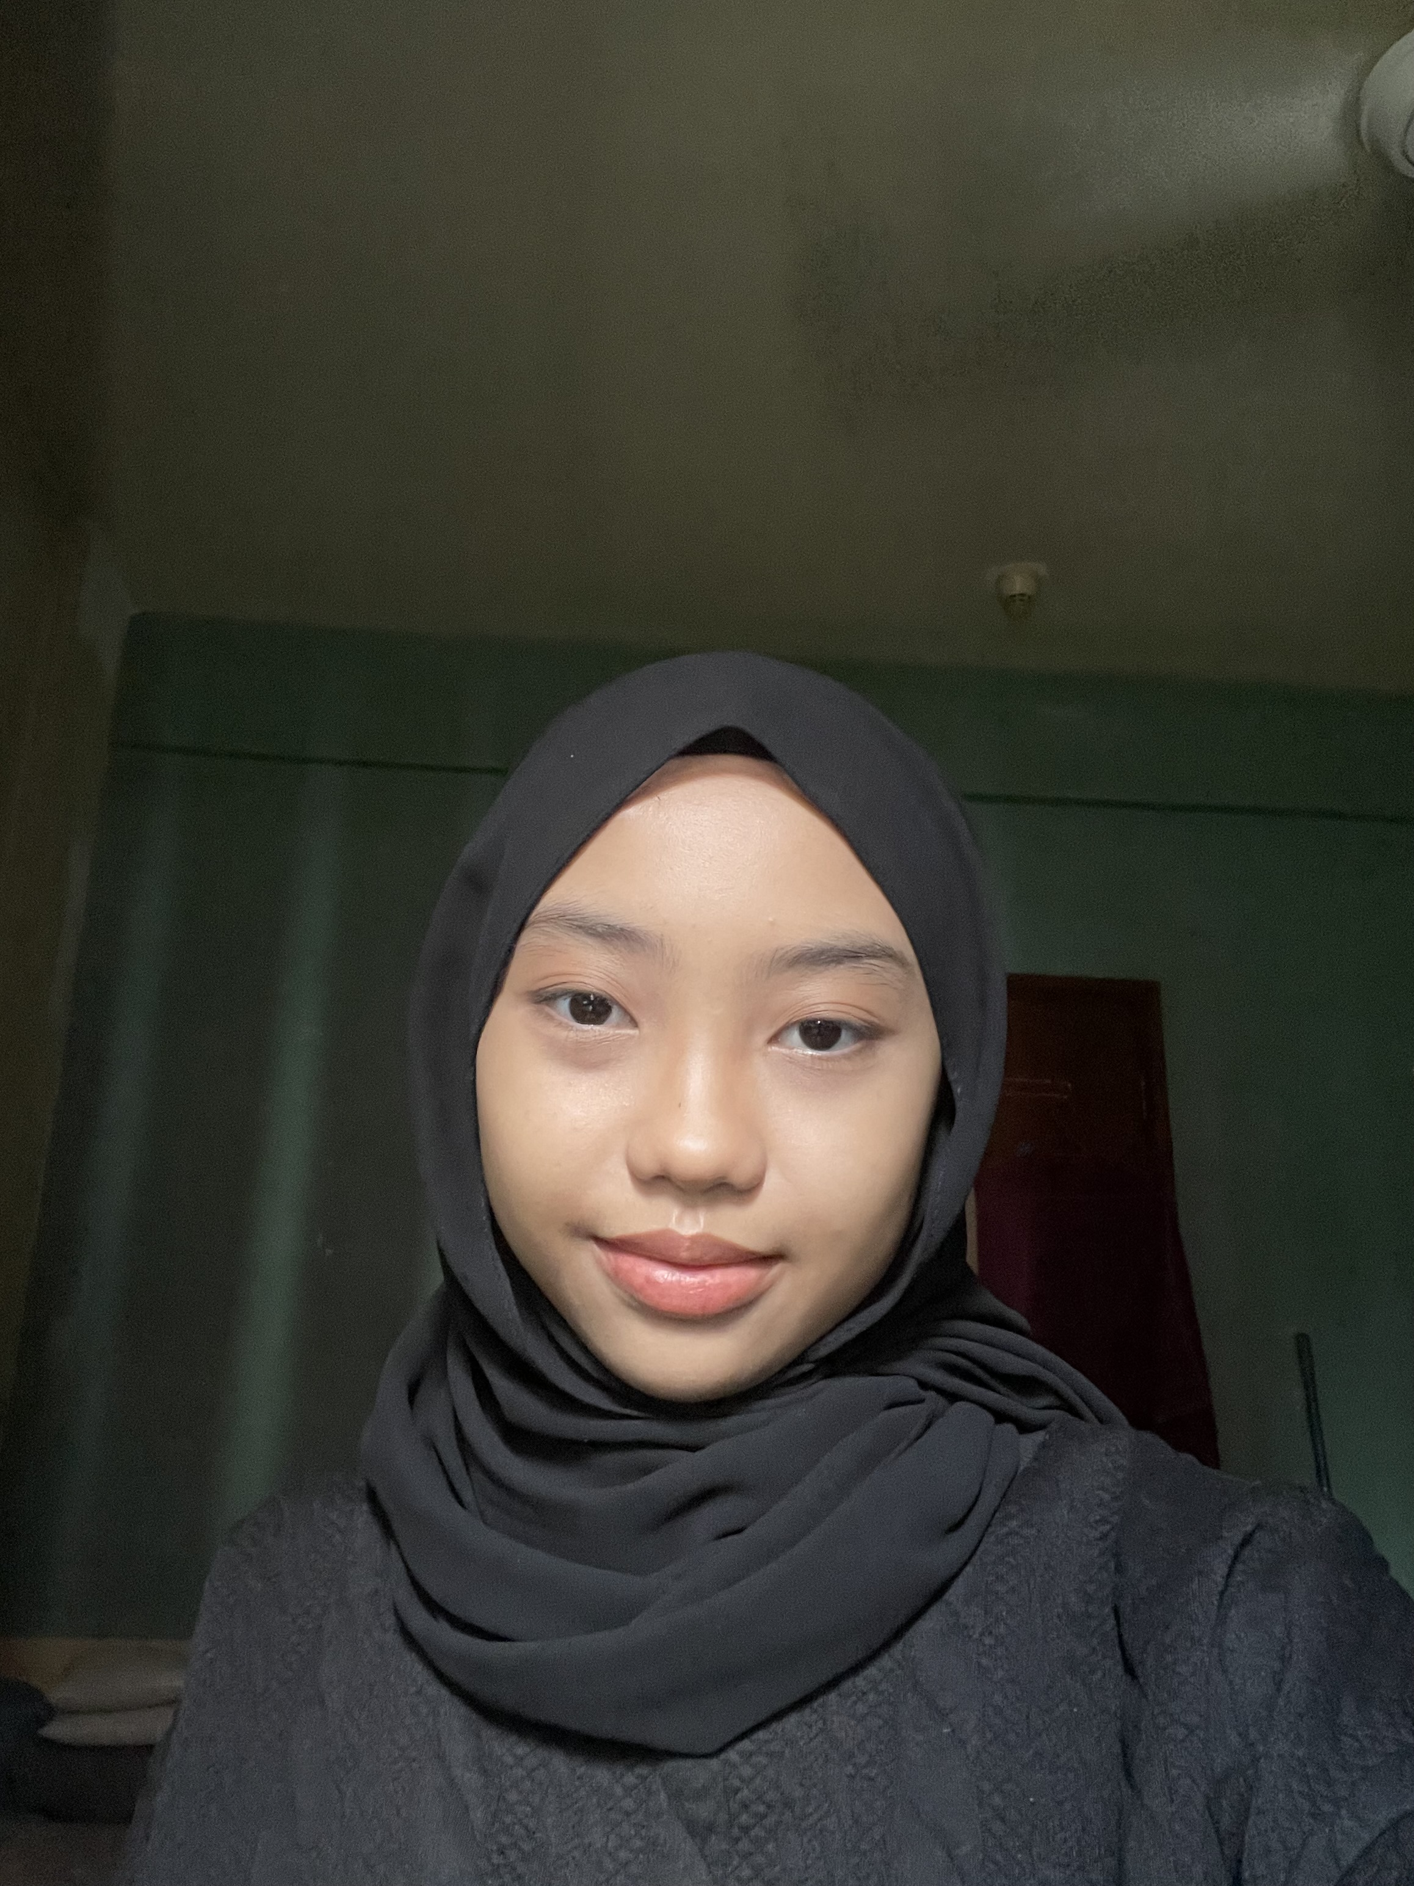
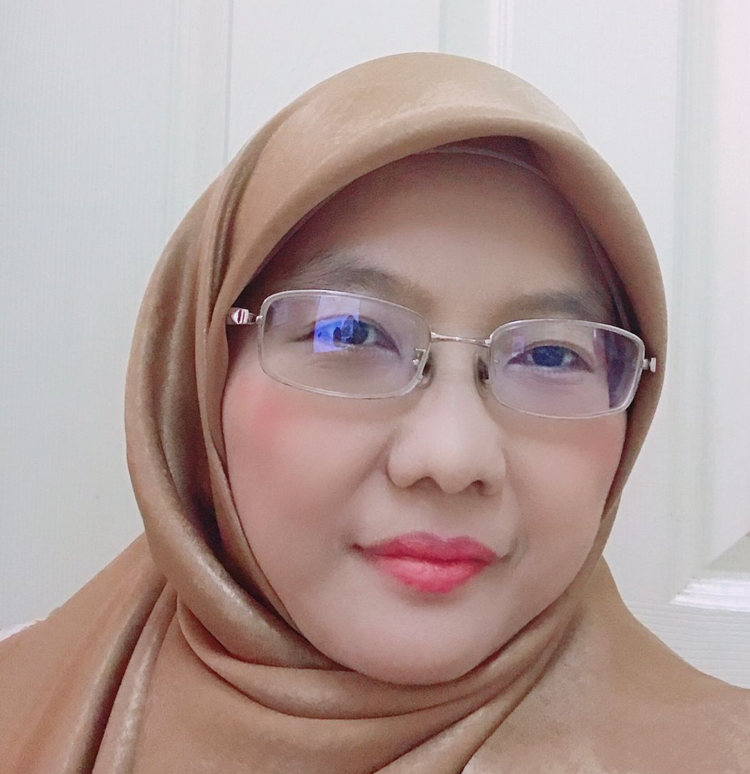
ABOUT US
Tan Yu Ting (19000505)
Derek Tan Weng Hin (19000371)
Mohammad Amirul Ikhwan Bin Shaiful Amir (19000685)
Ahmad Harith Bin Othman (19000893)
Nur Sabrena Natasha Binti Norizan(19000743)
Supervisor: Dr. Hazlina Binti Husin

Slide 3
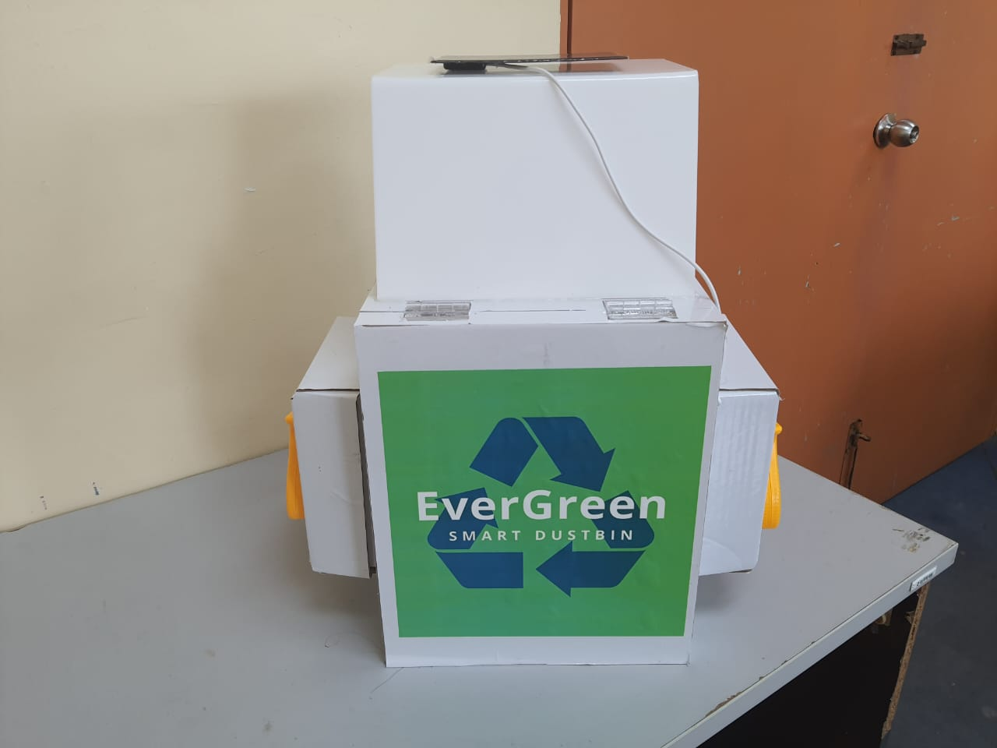
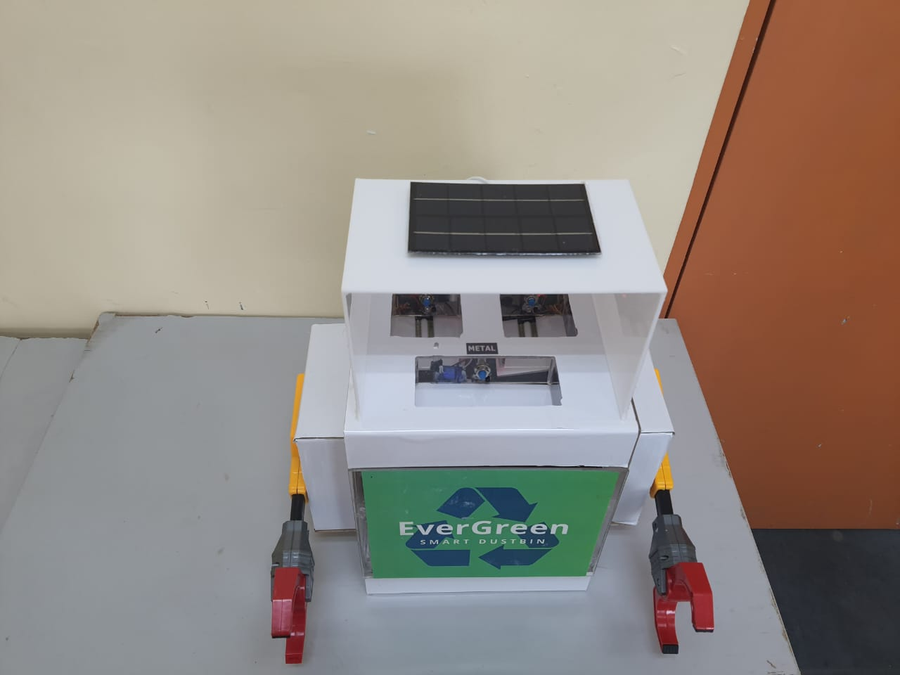
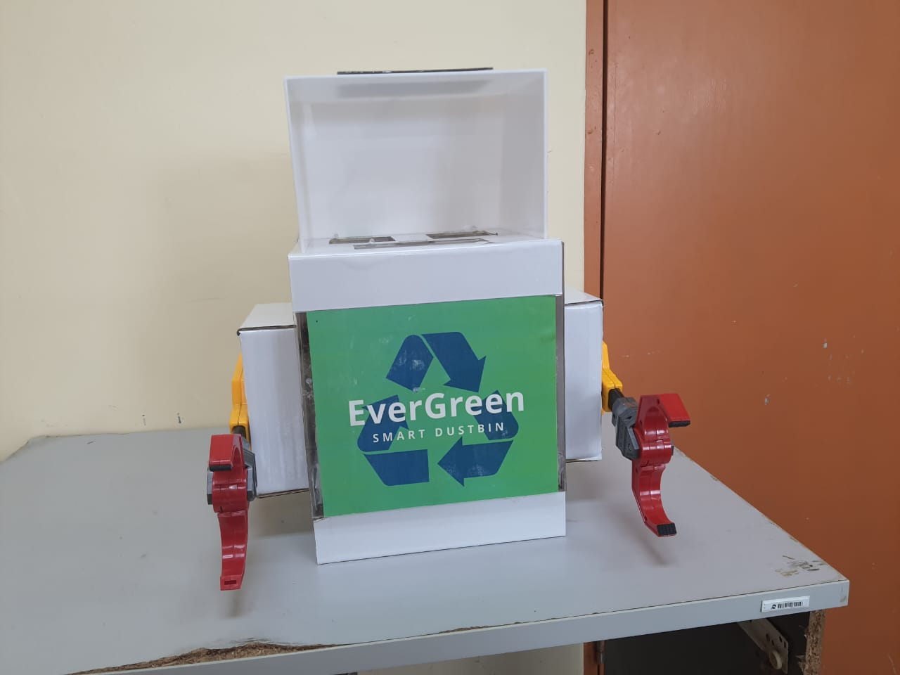
ABOUT PROTOTYPE
Prototype name: Evergreen Smart Dustbin

Slide 4
